Slide 1
Payments on the Android Platform
Kent Griffin (@kgriff03)
Praveen Alavilli (@ppalavilli)
www.x.com/mobile

Slide 2

Please press *0 if you experience any
audio difficulty or need technical assistance.
Audio Information:
US/Canada: 866.393.5811 Local/Intl: 706.679.2175 Passcode: 46622852

Slide 3

Q & A at the end but feel free to ask questions on twitter (http://twitter.com) – please use hashtag “#xwebinar”
Eg. How to use PayPal Android MPL for subscriptions? #xwebinar

Slide 4
Payments on the Android Platform
Kent Griffin (@kgriff03)
Praveen Alavilli (@ppalavilli)
www.x.com/mobile

Slide 5
AGENDA
Opportunities in Mobile Payments
PayPal Mobile Payments Library
PayPal Mobile Express Checkout
In-app Payments
PayPal Mobile Payments Library – implementation walk through
Advanced Features
Next steps (going live, tech support)

Slide 6

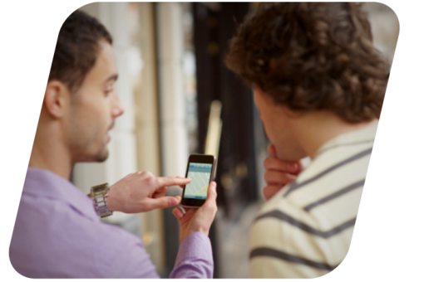

CONFLICTING STATEMENTS
US$119 billion
$633.4 billion
$984 billion
The worldwide market
for mobile payments
will grow to
$633.4 billion
by 2014, up from
$68.7 billion in 2009
(Generator– 5/2010
The total value of
global mobile
transactions will
increase from
$162 billion in 2010
to $984 billion in
2014
(Yankee – 2/2011)
M-Commerce is predicted to reach US$119 billion
in 2015, Japan remains king
(Gartner – 1/2011)

Slide 7
CONFLICTING STATEMENTS
US$119 billion
$633.4 billion
$984 billion
The worldwide market
for mobile payments
will grow to
$633.4 billion
by 2014, up from
$68.7 billion in 2009
(Generator– 5/2010
The total value of
global mobile
transactions will
increase from
$162 billion in 2010
to $984 billion in
2014
(Yankee – 2/2011)
M-Commerce is predicted to reach US$119 billion
in 2015, Japan remains king
(Gartner – 1/2011)

Slide 8
CONFLICTING STATEMENTS
US$119 billion
$633.4 billion
$984 billion
The worldwide market
for mobile payments
will grow to
$633.4 billion
by 2014, up from
$68.7 billion in 2009
(Generator– 5/2010
The total value of
global mobile
transactions will
increase from
$162 billion in 2010
to $984 billion in
2014
(Yankee – 2/2011)
M-Commerce is predicted to reach US$119 billion
in 2015, Japan remains king
(Gartner – 1/2011)

Slide 9

WHERE’S THE MONEY?
Much of the opportunity in mobile payments comes from outside digital content
Opportunity | Addressable Market
Digital content | $24B
Microfinance | $250B
Top up | $300B
Remittances | $400B
Non-traditional retail | $500B
Traditional retail | $5T
Source: McKinsey, Informa, Grameen Foundation

Slide 10
HOW TO MONETIZE IN YOUR APP
Indirect Monetization
Direct Monetization
Advertising
e/m-commerce
Freemium/Causium
Pay as you Use
Pay for App
Digital Goods
Virtual Currency
Offers
Subscriptions
Reselling
Referrals
Donations

Slide 11
HOW TO MONETIZE IN YOUR APP
Indirect Monetization
Direct Monetization
Advertising
e/m-commerce
Freemium/Causium
Pay as you Use
Pay for App
Digital Goods
Virtual Currency
Offers
Subscriptions
Reselling
Referrals
Donations

Slide 12
HOW TO MONETIZE IN YOUR APP
Indirect Monetization
Direct Monetization
Advertising
e/m-commerce
Freemium/Causium
Pay as you Use
Pay for App
Digital Goods
Virtual Currency
Offers
Subscriptions
Reselling
Referrals
Donations

Slide 13
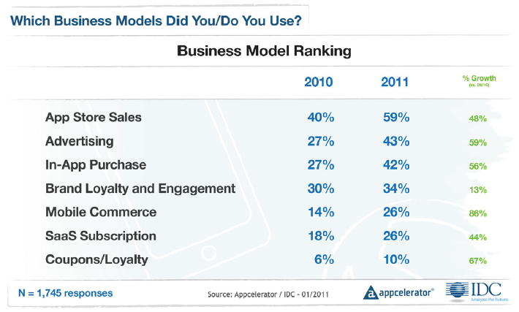
PREFERRED BUSINESS MODELS

Slide 14
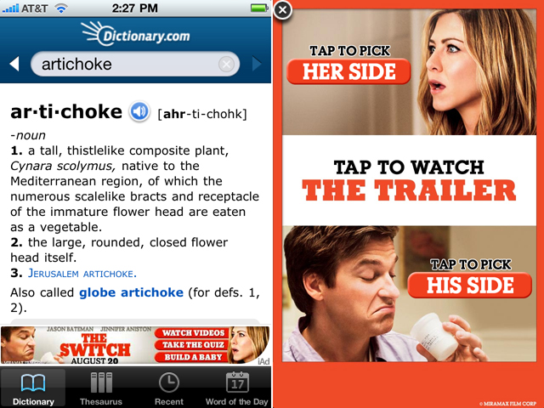
ADVERTISING
An option to supplement free content or services
Dictionary.com has seen its overall iPhone mobile app eCPM (effective cost-per-thousand impressions) increase by 177%
Source: Mashable (Jan 2011)
Notes:
engagement rates as high as 33% on rich media ads with rates consistently exceeding 20%. At the other end of the scale, simple, expandable ads reach 6-7% engagement rates, which can still be considered relatively high when compared to other advertising options including both mobile and online. These rates are unheard of in the online world. – aditic study
http://mashable.com/2010/08/19/mobile-advertising-trends/#

Slide 15
ADVERTISING
An option to supplement free content or services
Mobile Ad metrics:
Engagement rates up to
33% for rich media and
7% for expandable ads
Source: Adicit (Aug 2010)
Dictionary.com has seen its overall iPhone mobile app eCPM (effective cost-per-thousand impressions) increase by 177%
Source: Mashable (Jan 2011)
Notes:
engagement rates as high as 33% on rich media ads with rates consistently exceeding 20%. At the other end of the scale, simple, expandable ads reach 6-7% engagement rates, which can still be considered relatively high when compared to other advertising options including both mobile and online. These rates are unheard of in the online world. – aditic study
http://mashable.com/2010/08/19/mobile-advertising-trends/#

Slide 16
VIRTUAL GOODS
Great model for free apps able to up-sell features or content
Others use it as a way to pay for an ad-free app
30% fee

Slide 17
VIRTUAL GOODS
Great model for free apps able to up-sell features or content
Others use it as a way to pay for an ad-free app
30% fee
Source: Playspan survey (Sept 09)

Slide 18
VIRTUAL GOODS
Great model for free apps able to up-sell features or content
Others use it as a way to pay for an ad-free app
30% fee
Kleiner Perkins Case Study
Virtual goods introduction drove 5x increase in revenue over paid apps
2009 Revenue: 64% paid downloads, 30% ads
2010 Revenue: 63% ads, 35% virtual goods
Source: Kleiner Perkins Mobile Trends Report (Feb 2011)
Source: Playspan survey (Sept 09)

Slide 19
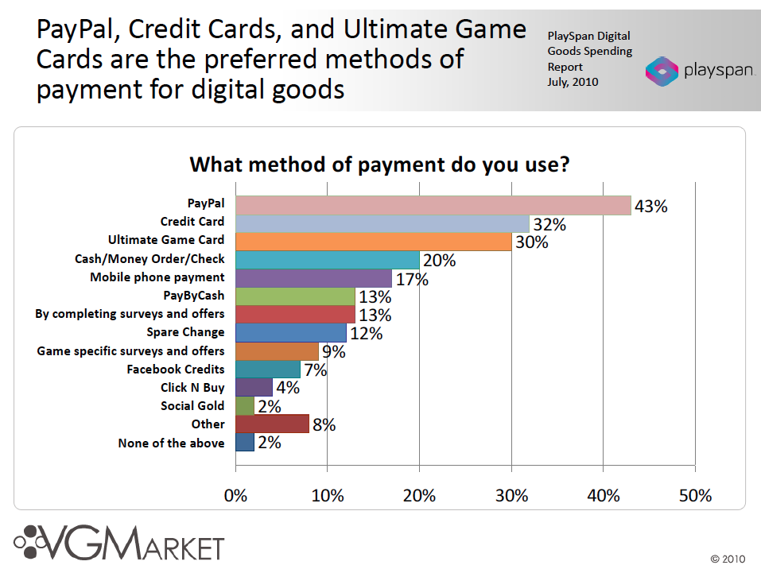

Slide 20
PayPal’s Mobile Payment Library
Making it easier for developers
Designed to be integrated in less than 10 minutes
No need to code payment UI
Don’t need to worry about sensitive financial info

Slide 21
PayPal’s Mobile Payment Library
Making it easier for developers
Designed to be integrated in less than 10 minutes
No need to code payment UI
Don’t need to worry about sensitive financial info
More convenient than always typing credit card
Can use existing account information
Making it better for consumers

Slide 22
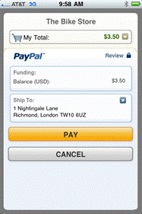
PayPal’s Mobile Payment Library
Making it easier for developers
Designed to be integrated in less than 10 minutes
No need to code payment UI
Don’t need to worry about sensitive financial info
More convenient than always typing credit card
Can use existing account information
Physical goods and services
In-app purchase
Simple, Chained, Parallel, and Pre-approved payments
Supports Android 1.5 and above (and iOS 3.0 and above)
Making it better for consumers
A growing feature set

Slide 23
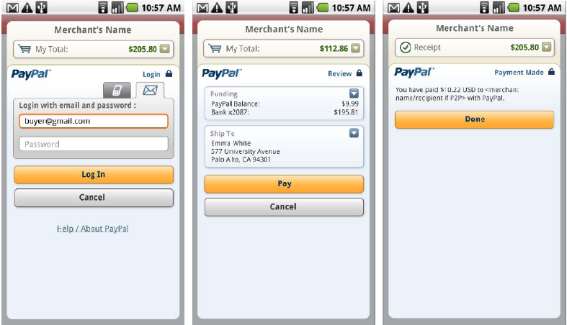
Simple in-app Payment Demo
Notes:
MPL and MEC

Slide 24
Simple in-app Payment Demo
Notes:
MPL and MEC

Slide 25
Simple in-app Payment Demo
Notes:
MPL and MEC

Slide 26
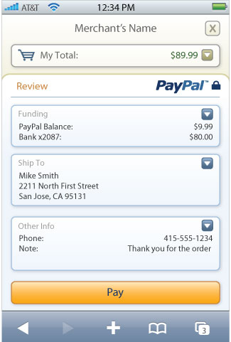
Mobile Express Checkout: Overview
Mobile Express Checkout used by top merchants (Nike.com, Buy.com, Footlocker.com)
Optimized UI for webkit browsers
Supports iPhone and Android 2.0 browsers
Uses the same APIs as the web version so any online integrations can be reused
More information at www.x.com/mobile
Notes:
Note: App developers may want to use the mobile
web if you already have an EC integration
or the app store requires a web flow.

Slide 27
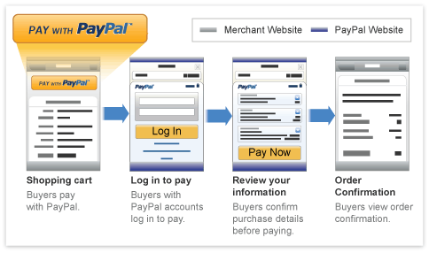
Mobile Express Checkout
Notes:
Demo

Slide 28
“In-APP Payments”

Slide 29

What are In-App Payments (Billing)?
Payments made inside an app
Users never leave the app
Contextual and Trusted experience

Slide 30
What Are Your Options?
Google
PayPal
Digital goods
Virtual currencies
Premium features
(Digital content subscriptions)
Physical goods
P2P payments
Service payments
e/m-commerce
Donations
Crowd Sourcing
Subscriptions
SaaS Payments
Non-traditional commerce
Other Providers:
Use cases vary

Slide 31

Google In-App Payments
Supported through Android Market in-app billing service for requesting and validating the form of payment and processing the financial transactions
http://developer.android.com/guide/market/billing/index.html

Slide 32
PayPal In-App Payments
Supported through a library that includes both Activities and Views required for “inline” checkout experience.
Over 190 countries and 25 different currencies – global ready from get go!
Simple, Chained, Parallel and Preapproval payments
Refunds, Transaction details, Instant Payment notifications

Slide 33
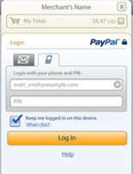
PayPal In-App – Component Diagram
Your Application
Your Server
(Optional)
Your Activity
onCreate(){
…
getCheckoutButton(…);
}
onClickListener() {
…
startActivityForResult(…);
}
onPaymentSucceeded() {
…
}
onPaymentFailed(){
…
}
onPaymentCanceled() {
…
}
onActivityResult(){
…
}
Item delivery
Purchase data
PayPal Checkout Activity
Instant Payment
Notifications
(Optional)
PayPal Server
User Wallet
Fraud/Risk
Transaction data

Slide 34
Let’s build an app https://github.com/paypalx/tech-talks Look for “MPLforAndroid-Webinar-March2011”

Slide 35
Integration Steps
Download the library from x.com/mobile and import into your application
Update your AndroidManifest.xml
Initialize the PayPal library
Generate and insert the PayPal button w/ onClickListener()
Start Payment Activity using Checkout intent
Handle ActivityResult from PayPal Activity

Slide 36
Advanced Functionality
ResultDelegate
Chained, Parallel and Preapproved Payments
Dynamic Amount Calculation
more…

Slide 37
ResultDelegate
Implement PayPalResultDelegate interface
Provides a way to be notified immediately when a payment has completed
Get’s called before the PayPal MPL Activity is returned (onActivityResult())

Slide 38
ResultDelegate
Implement PayPalResultDelegate interface
Provides a way to be notified immediately when a payment has completed
Get’s called before the PayPal MPL Activity is returned (onActivityResult())
public interface PayPalResultDelegate{
void onPaymentSucceeded(String payKey, String paymentStatus);
void onPaymentFailed(String paymentStatus, String correlationID, String payKey, String errorID, String errorMessage);
void onPaymentCanceled(String paymentStatus);
}

Slide 39



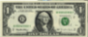

Chained, Parallel and Preapproved Payments
$100
$10
$100
$10
$40
$40
Primary
$50
Parallel Payment
$50
Chained Payment
Pre Approval
C

Slide 40
Dynamic Amount Calculation
Allows modification of the payment (Amount, tax, shipping) based on the buyer’s shipping address
Enable by setting payPal.setDynamicAmountCalculationEnabled(true);
Implement PaymentAdjuster interface

Slide 41
Dynamic Amount Calculation
Allows modification of the payment (Amount, tax, shipping) based on the buyer’s shipping address
Enable by setting payPal.setDynamicAmountCalculationEnabled(true);
Implement PaymentAdjuster interface
public interface PaymentAdjuster {
public MEPAmounts adjustAmount(MEPAddress address, String currency, String tax, String shipping);
public Vector<MEPReceiverAmounts> adjustAmountsAdvanced(MEPAddress address, String currency, Vector<MEPReceiverAmounts> receivers);
}

Slide 42

More…
Instant Payment Notifications
Refunds
Transaction Search/Details

Slide 43
Next Steps

Slide 44
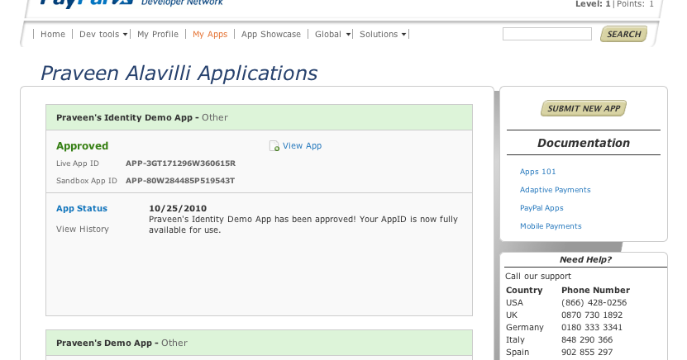
Going Live

Slide 45


Going Live
Update your AppID
Submit your app for App Store/Marketplace

Slide 46
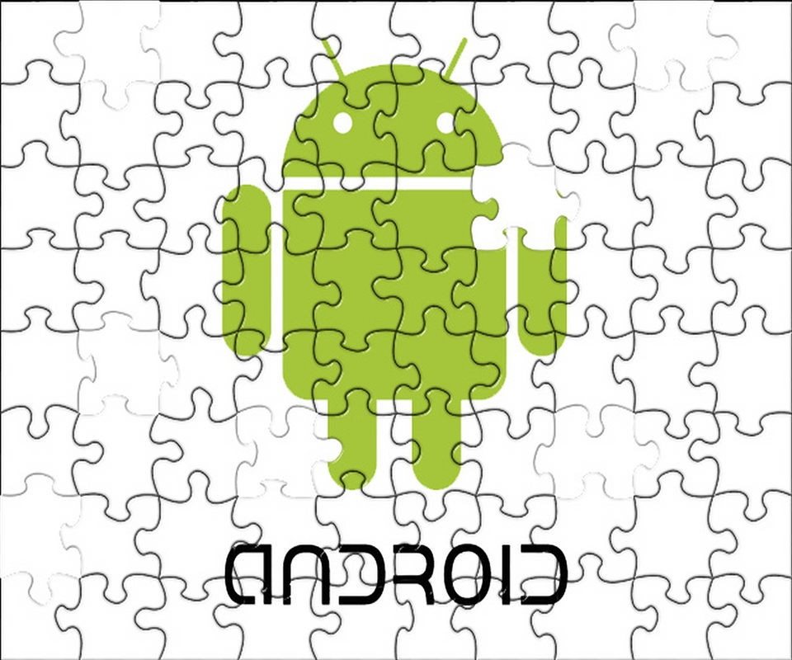
PayPal X Developer Challenge for AndroidTM
Use what you’ve learned today to add PayPal payments to your Android app, and enter the PayPal X Dev Challenge! Win up to $25K in prizes, as well as marketing and PR support. Deadline to enter is May 14th.
https://www.x.com/devchallenge

Slide 47

Questions
www.x.com
www.x.com/mobile
www.paypal.com/dts@paypalx
facebook.com/paypalx

Slide 48
appendix

Slide 49
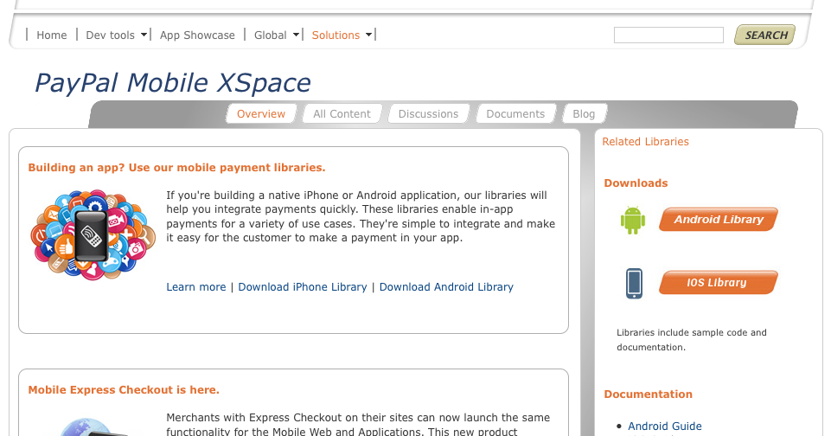
Step 1: Download the library & add it to your app
https://www.x.com/mobile

Slide 50
Step 2: Update your AndroidManifest.xml
Add permissions:
<uses-permission android:name="android.permission.INTERNET" />
<uses-permission android:name="android.permission.READ_PHONE_STATE"/>
Declare the PayPal Activity:
<activity android:name="com.paypal.android.MEP.PayPalActivity"
android:theme="@android:style/Theme.Translucent.NoTitleBar"
android:configChanges="keyboardHidden|orientation"/>

Slide 51
Step 3: initialize the library
public void onCreate() {
…..
if(this.isOnline()){
Thread libraryInitializationThread = new Thread() {
public void run() {
initLibrary();
}
};
libraryInitializationThread.start();
}
….
}

Slide 52
Step 3: initialize the library
public void initLibrary() {
PayPal pp = PayPal.getInstance();
// If the library is already initialized, then we don't need to
// initialize it again.
if (pp == null) {
// This is the main initialization call that takes in your Context,
// the Application ID, and the server you would like to connect to.
pp = PayPal.initWithAppID(this, "APP-80W284485P519543T",
PayPal.ENV_NONE);
// -- These are required settings.
pp.setLanguage("en_US"); // Sets the language for the library.
// --
// -- These are a few of the optional settings.
// Sets the fees payer. If there are fees for the transaction, this
// person will pay for them. Possible values are FEEPAYER_SENDER,
// FEEPAYER_PRIMARYRECEIVER, FEEPAYER_EACHRECEIVER, and
// FEEPAYER_SECONDARYONLY.
pp.setFeesPayer(PayPal.FEEPAYER_EACHRECEIVER);
// Set to true if the transaction will require shipping.
pp.setShippingEnabled(true);
// Dynamic Amount Calculation allows you to set tax and shipping
// amounts based on the user's shipping address. Shipping must be
// enabled for Dynamic Amount Calculation. This also requires you to
// create a class that implements PaymentAdjuster and Serializable.
pp.setDynamicAmountCalculationEnabled(false);
// --
_paypalLibraryInit = true;
}
}

Slide 53
Step 4: generate PayPal button w/ onClickListener
private void showPayPalButton() {
removePayPalButton();
// Back in the UI thread -- show the "Pay with PayPal" button
// Generate the PayPal Checkout button and save it for later use
PayPal pp = PayPal.getInstance();
launchPayPalButton = pp.getCheckoutButton(this, PayPal.BUTTON_278x43,
CheckoutButton.TEXT_PAY);
// You'll need to have an OnClickListener for the CheckoutButton.
launchPayPalButton.setOnClickListener(this);
// add it to the layout
RelativeLayout.LayoutParams params = new RelativeLayout.LayoutParams(
LayoutParams.WRAP_CONTENT, LayoutParams.WRAP_CONTENT);
params.addRule(RelativeLayout.ALIGN_PARENT_BOTTOM);
params.bottomMargin = 10;
launchPayPalButton.setLayoutParams(params);
launchPayPalButton.setId(PAYPAL_BUTTON_ID);
((RelativeLayout) findViewById(R.id.RelativeLayout01))
.addView(launchPayPalButton);
((RelativeLayout) findViewById(R.id.RelativeLayout01))
.setGravity(Gravity.CENTER_HORIZONTAL);

Slide 54
Step 4: generate PayPal button w/ onClickListener
private void removePayPalButton() {
// Avoid an exception for setting a parent more than once
if (launchPayPalButton != null) {
((RelativeLayout) findViewById(R.id.RelativeLayout01))
.removeView(launchPayPalButton);
}
}

Slide 55
Step 5: Start payment Activity using Checkout Intent
public void PayPalButtonClick(View arg0) {
// Create a basic PayPalPayment.
PayPalPayment payment = new PayPalPayment();
// Sets the currency type for this payment.
payment.setCurrencyType("USD");
// Sets the recipient for the payment. This can also be a phone
// number.
payment.setRecipient("ppalav_1285013097_biz@yahoo.com");
// Sets the amount of the payment, not including tax and shipping
// amounts.
payment.setSubtotal(new BigDecimal(_theSubtotal));
// Sets the payment type. This can be PAYMENT_TYPE_GOODS,
// PAYMENT_TYPE_SERVICE, PAYMENT_TYPE_PERSONAL, or
// PAYMENT_TYPE_NONE.
payment.setPaymentType(PayPal.PAYMENT_TYPE_GOODS);
// PayPalInvoiceData can contain tax and shipping amounts. It also
// contains an ArrayList of PayPalInvoiceItem which can
// be filled out. These are not required for any transaction.
PayPalInvoiceData invoice = new PayPalInvoiceData();
// Sets the tax amount.
invoice.setTax(new BigDecimal(_taxAmount));

Slide 56
Step 6: Handle result from library
public void PayPalActivityResult(int requestCode, int resultCode, Intent intent) {
switch (resultCode) {
case Activity.RESULT_OK:
// The payment succeeded
String payKey = intent.getStringExtra(PayPalActivity.EXTRA_PAY_KEY);
this.paymentSucceeded(payKey);
break;
case Activity.RESULT_CANCELED:
// The payment was canceled
this.paymentCanceled();
break;
case PayPalActivity.RESULT_FAILURE:
// The payment failed -- we get the error from the
// EXTRA_ERROR_ID and EXTRA_ERROR_MESSAGE
String errorID = intent.getStringExtra(PayPalActivity.EXTRA_ERROR_ID);
String errorMessage = intent.getStringExtra(PayPalActivity.EXTRA_ERROR_MESSAGE);
this.paymentFailed(errorID, errorMessage);
}
}

